Slide 1


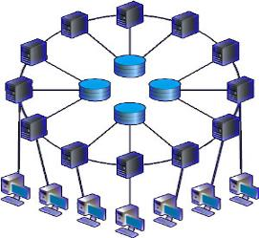
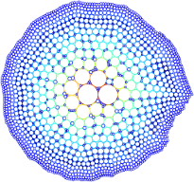
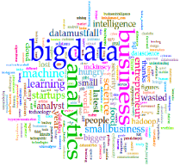
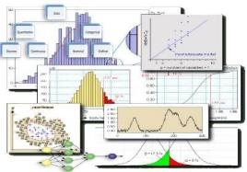

Universitas Hasanuddin
Fakultas MIPA – Departemen Statistika
Makassar, 03-04 Februari 2020
“Your partner in data solution, research, & education”
Pendahuluan Text Mining dan Social Media Analytics via Python
Taufik Sutanto
https://tau-data.id/unhas

Slide 2


























S.Si, MScTech, PhD
TAUFIK SUTANTO
“Your partner in data solution, research, & education”
Specialization:
Data Science, Big Data, Parallel & Distributed Computing, Machine Learning, Applied Mathematics & Statistics, Information System.
Current Position:
Founder, tau-data Indonesia
Lecturer, University of Indonesia & UIN Jakarta
Education:
Queensland University of Technology (PhD – Data Science for Big Data)
Tohoku University (Research Program, Machine Learning)
University of New South Wales (MScTech – Data Mining)
University of Indonesia (Ssi – Mathematics/Computational Statistics)
Awards: Australia Leaderships Awards & Outstanding student awards
Contact:
taufik@tau-data.id – 0822 9120 3030
Some (Big) Data Science Project/Training Experience (partners):

Slide 3
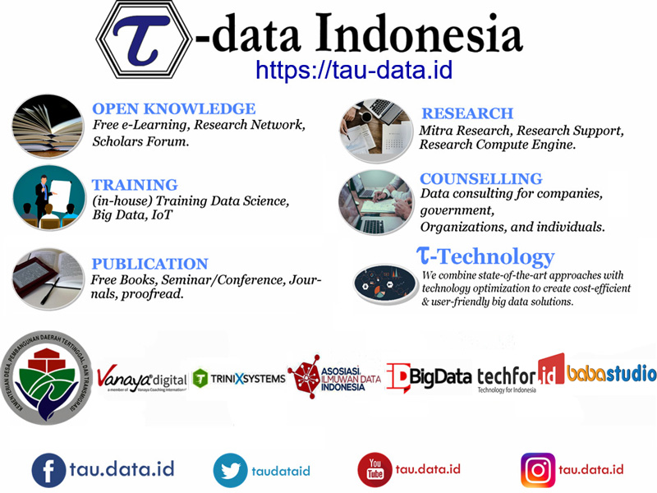









Slide 4
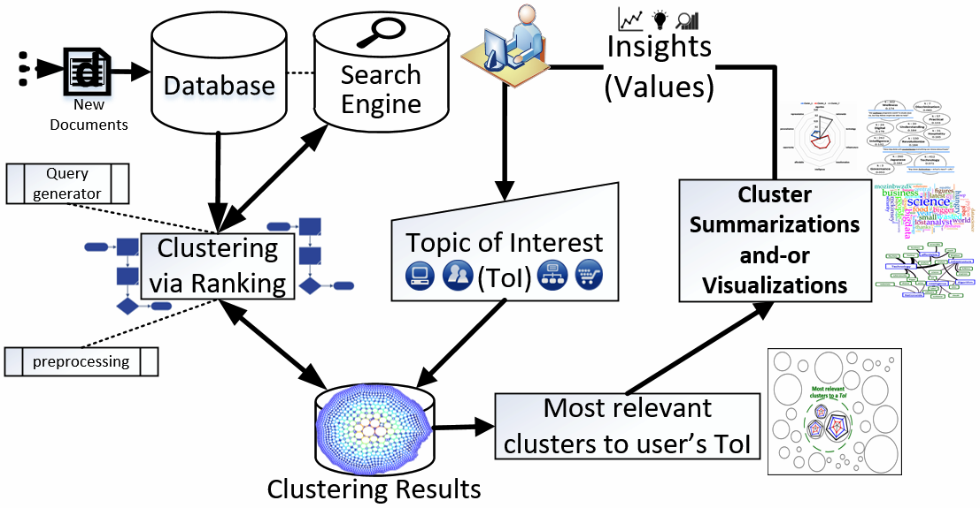
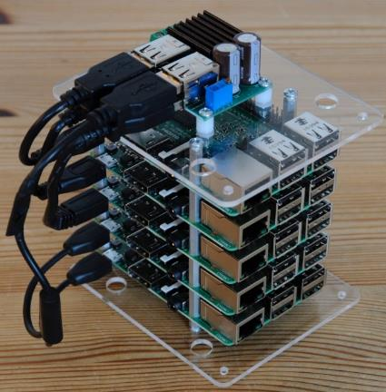
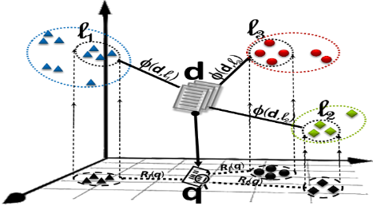
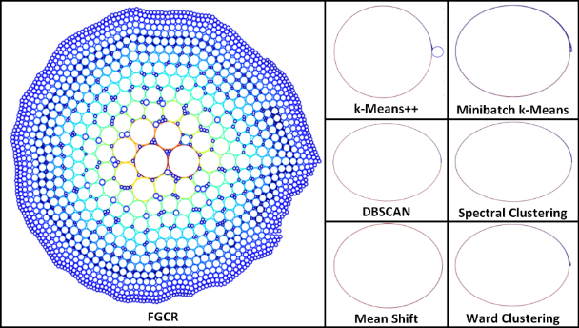
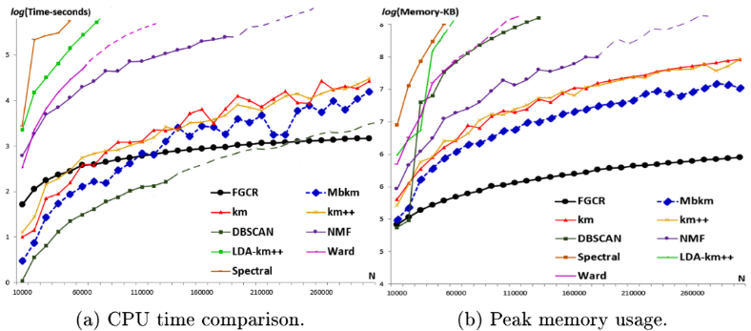
My Research: Data Science, IoT, Big Data

Slide 5

“Tak Kenal Maka Tak Sayang”
Nama, Dosen jurusan, mata kuliah yang diajarkan, bidang penelitan?
Berapa banyak yang sudah belajar Data Mining/Machine Learning/Data Science sebelumnya? [Minimal 6 bulan]
Siapa yang belum pernah menggunakan Python sama sekali?
Ada yang belum familiar dengan bahasa pemrograman apapun?

Slide 6

Outline Workshop
Senin, 03 Feb 2020:
09.00-10.30: Pendahuluan Data Science & Big Data
10.30-12.00: Pendahuluan Python
12.00-13.00: Ishoma
13.00-16.00: Pendahuluan Natural Language Processing
Selasa, 04 Feb 2020:
09.00-10.00: Crawling, Streaming, & Scrapping
10.00-12.00: Text Analytics dan Sentiment Analysis
12.00-13.00: Ishoma
13.00-16.00: Topic Modelling dan Social Network Analytics

Slide 7
Tujuan Workshop
Memperkenalkan Big Data (BD), Data Science (DS), Machine Learning (ML), dan Artificial Intelligence (AI) serta potensinya dalam dunia Akademis, dan industri.
Membahas trend terkini BD dan AI dan prediksi pengembangannya di masa depan.
Memperkenalkan tools Python dalam melakukan Text Mining dan Social Media Analytics.
Memperkenalkan pengolahan data tidak terstruktur (teks) yang berasal dari media sosial dan website.
Fokus ke Text Mining, NLP dibahas sebagai fondasi dasar Text Mining.
Kasus bahasa yang akan dibahas: Inggris dan Indonesia

Slide 8
Outline Module 01
Pendahuluan Industri 4.0, Data Science & Big Data
Teknologi: Database, Komputasi, & Pemrograman
Contoh kasus Data Science dan Big Data
Peluang dan Tantangan
Masa Depan Data Science dan Big Data
Pendidikan/Kurikulum Data Analyst/Science/Engineer
Diskusi

Slide 9
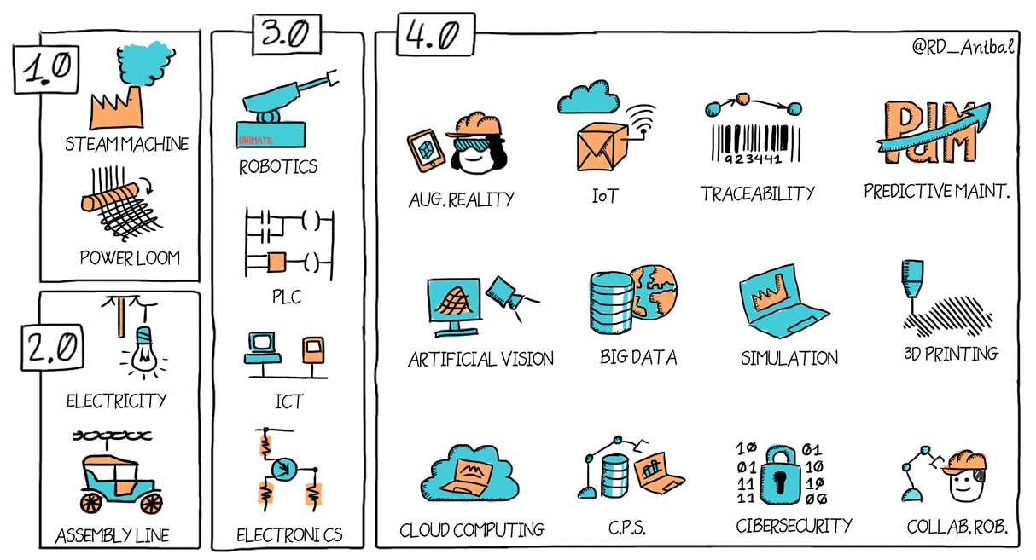
Industri 4.0?
Mechanical Loom 1784
Cyber Physical System Smart Automation - 2015
Slaughter House Cincinati -1870
Programmable Logic
Controller - 1969
Notes:
Saya fikir hal ini sdh tidak asing lagi.
Industri 4.0 adalah milestone atau penanda era, dimulai dengan penggunaan mesin uap, listrik, robot, hingga saat ini Data, Science, IoT, dan Big Data.
“Jaman telah berubah”
Industry 4.0 jika dirangkum dalam satu kata adalah “Data”

Slide 10
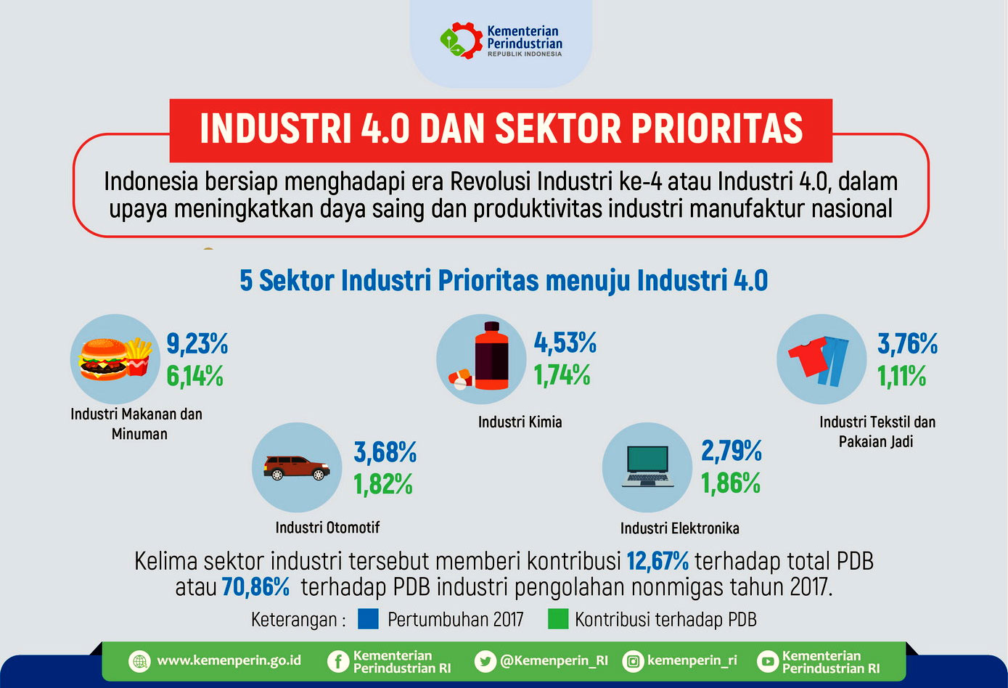
Industri 4.0 - Indonesia
Notes:
Release dari Kementrian Perindustrian
Arguable

Slide 11
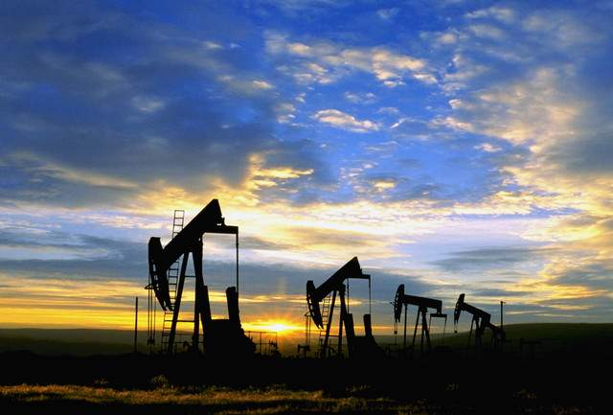



Industri 4.0 = DATA
Data adalah minyak baru. Data seperti minyak mentah yang berharga, tetapi jika tidak dikelola dengan baik maka data tidak dapat digunakan.
– Clive Humby, DunnHumby
Untuk pertama kalinya kita memiliki sebuah perekonomian yang berdasarkan pada sebuah sumber daya utama (informasi) yang tidak hanya terbarukan, tetapi terus bertambah.
– John Naisbitt
Notes:
Oil vs Data
11

Slide 12



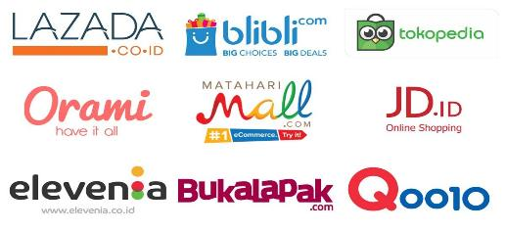




Potensi Kreativitas yang Tak Berbatas di Era Digital
Perusahaan besar akomodasi (penginapan) tidak memiliki hotel.
Perusahaan besar transportasi tidak memiliki armadanya sendiri.
Toko online, universitas, dsb.

Slide 13











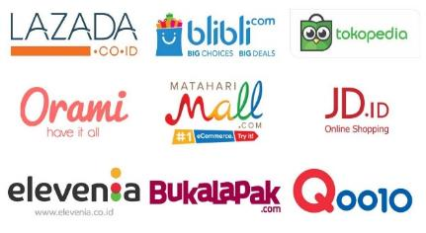
Era Industri Data
DATA
Militer
Keuangan
Retail
Transportasi & Akomodasi
Industri IT

Slide 14
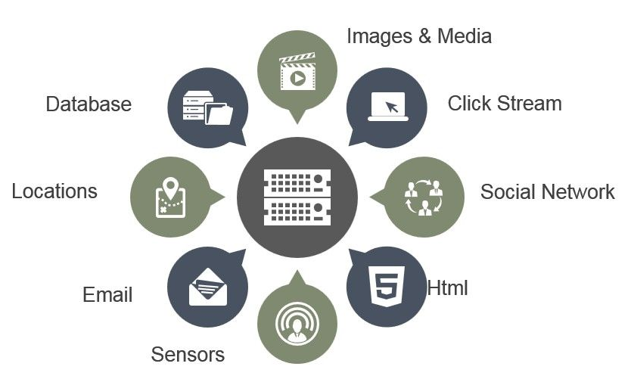

Sumber Data

Slide 15
Pertumbuhan Data (Tidak Terstruktur)
⇓
Big Data

Slide 16
Terminology & Definisi
Notes:
Mengapa TNI harus mengikuti perkembangan ini?

Slide 17

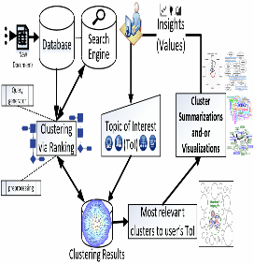
Definisi Big Data
Big Data adalah sebuah istilah untuk suatu permasalahan data yang memiliki tiga karakteristik utama yaitu Volume, Velocity, dan Variety.
Catatan: Big Data ≠ Large Data Kata Kunci: NoSQL, IoT, Hadoop, Spark, Map-reduce, dsb.
Volume
Ukuran Data
Velocity
Kecepatan Data
Variety
Keragaman Data

Slide 18
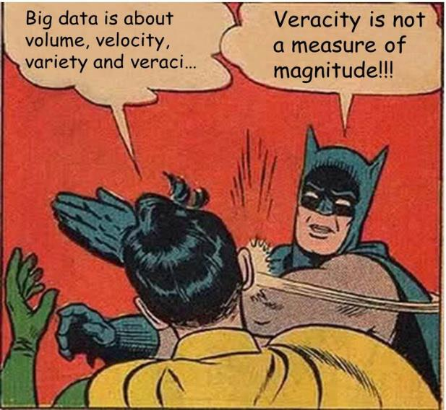
Big Data Characteristics
But wait !!!....
Volume : Ukuran data yang (sangat) besar
Velocity : Pertumbuhan data yang cepat
Variety : Format data yang beragam
Values : $$$
Veracity : Kualitas data
Variability : “Distribusi” data
Visualization : hmmm… wut? …
Vexing : …? …. (genome)
Notes:
Leave the exact definition BD : should also contain not only the characteristics of the data, but also the technology, and the methods involved in analyzing them.
Vexing in Genomic

Slide 19
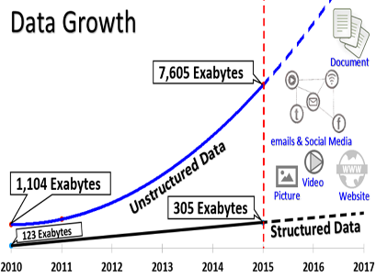

Big Data Properties
Pengguna menghasilkan data (User Generated content)
Dynamic and active user engagement (ChatBot & machine Learning)
Minim filter (Noisy Data)
Wide and large Coverage
Temporal information: (need quick response)
Notes:
Big Data adalah istilah, bukan plain English.

Slide 20
Big Data
“We can have a problem with a (very) large data, but still not a Big Data Problem.”
Example (and why)?
Big Data tidak hanya tentang besarnya data, tapi juga kompleksitas masalah.

Slide 21
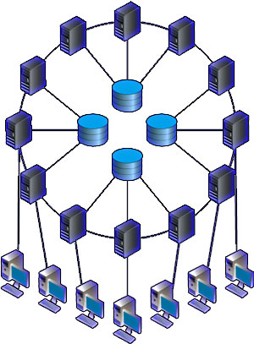
Big Data: Distributed Data & Computing
HACE Theorem:
“Big Data starts with large-volume, heterogeneous, autonomous sources with distributed and decentralized control, and seeks to explore complex and evolving relationships among data”
(Xindong et al. 2014).
Scalable
Cost Effective
Robust/
Fault Tolerance
Privacy
Security

Slide 22
DS~BD General Challenges
Need large scale infrastructure to optimize investment/profit ratio.
Storing Data $$$ ↓↓↓, but Analyzing Data $$$↑↑↑
Ethics/Legal issues
Confusing: too many framework and technology
Notes:
Selain itu ada technical challenges

Slide 23
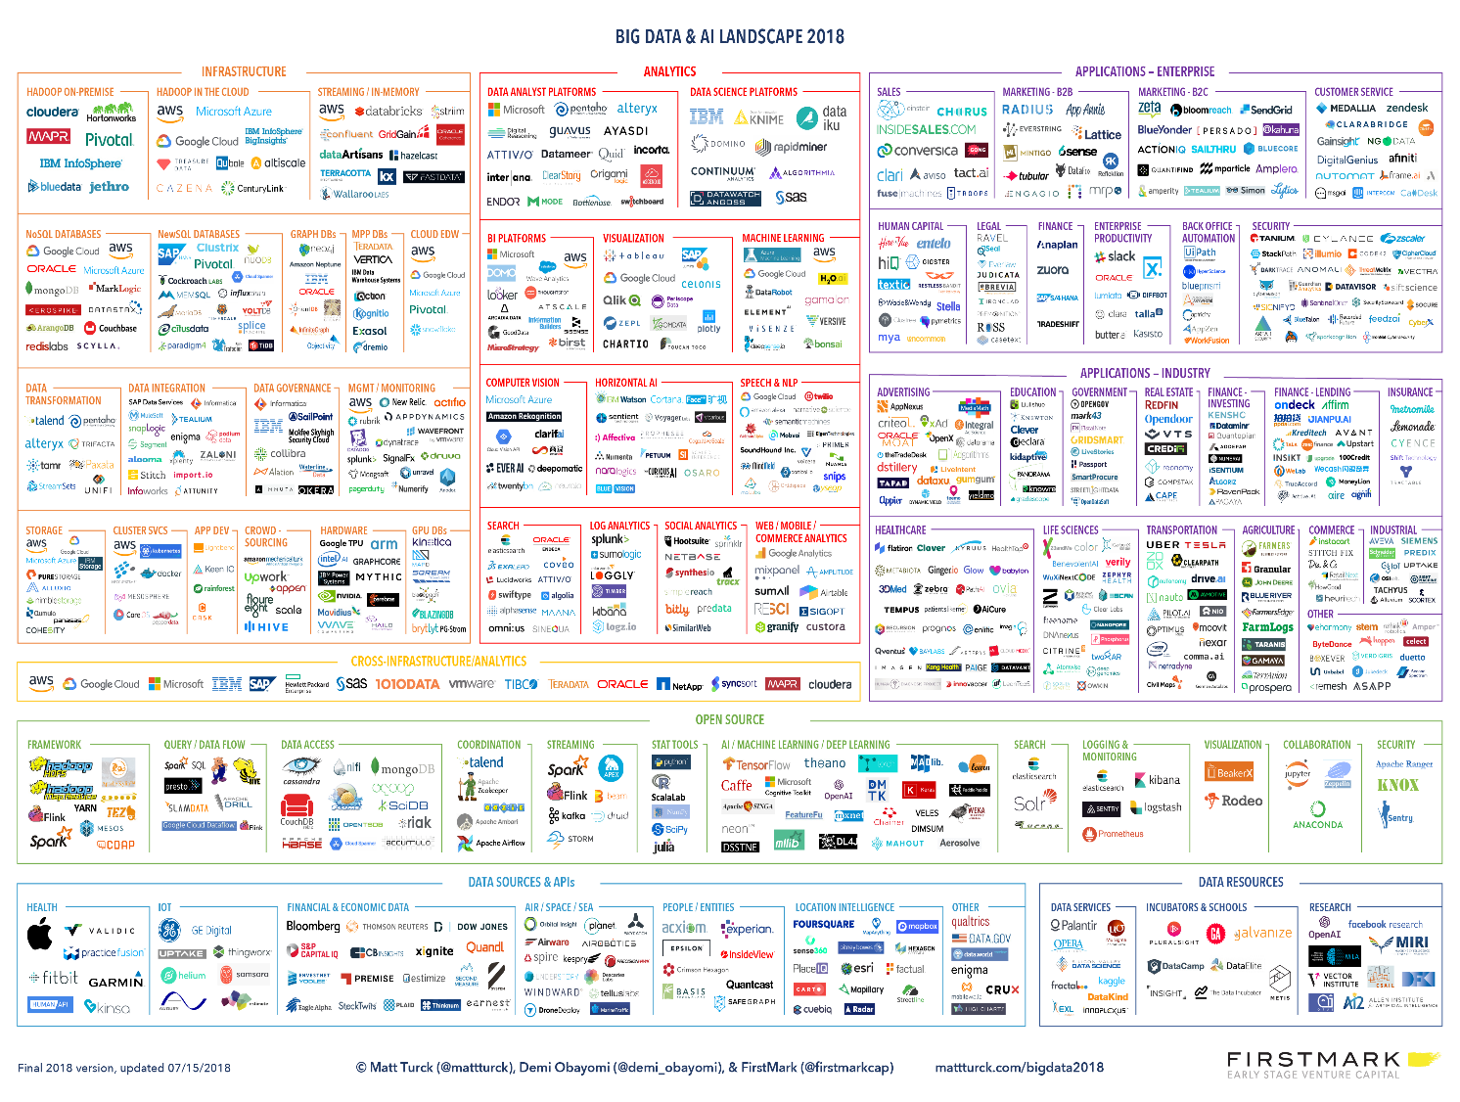
Notes:
Belajar satu framework mahal & susah, Jadinya fanatik
Setiap framework optimal hanya utk suatu masalah khusus

Slide 24







Unlike how conventional statistics is done, Big data technology is specific to an application(s)
https://www.edureka.co/blog/5+Reasons-when-to-use-and-not-to-use-hadoop/
http://mahout.apache.org/users/basics/algorithms.html
(-) Real-time processing
(-) Security
(-) No conception of indexing (full scan)
(-) Difficult to code (use with care)
(+) Variety, Volume, Velocity
(+) Open source
Notes:
“if the only tool you have is a hammer, all the problems look like nails”

Slide 25
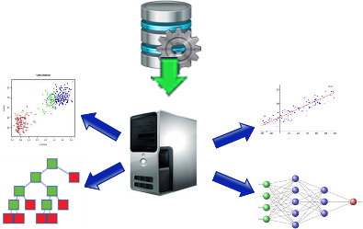
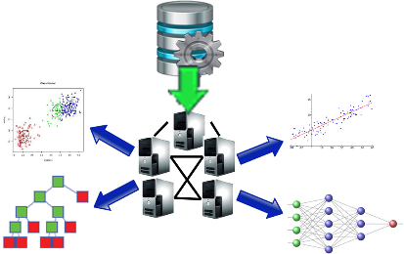
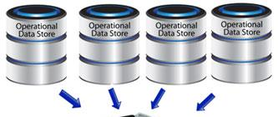
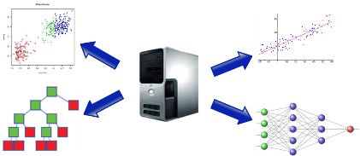
Data~Komputasi : Centralized~Distributed
Centralized Data & Computation
Centralized Data,
Distributed Computing
3. Distributed Data,
Centralized Computing
4. Distributed Data,
Distributed Computing

Slide 26
Big Data Spectrum
Social Aspects
Applications
Law
Ethics
Politics
Methodology
Economy
Education
Government
Privacy
Technology
Democracy
Research
Analytics
Big
Prediction
Finance/ Bank
Industry
Insights
IoT
Data
Mobiles
Values
Security
Cluster- Computers
NoSQL
Health
Social media
Retails
Classification
Clustering
Visualizations
©Taufik Sutanto - 2019

Slide 27
Data Science ?

Slide 28

Data Science = Statistics?
Notes:
Cerita kuliah umum di UI

Slide 29
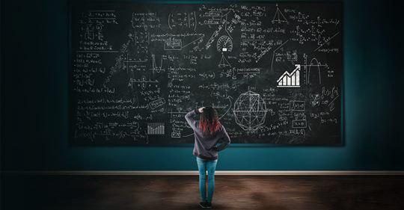
Data Science = Mathematics?

Slide 30
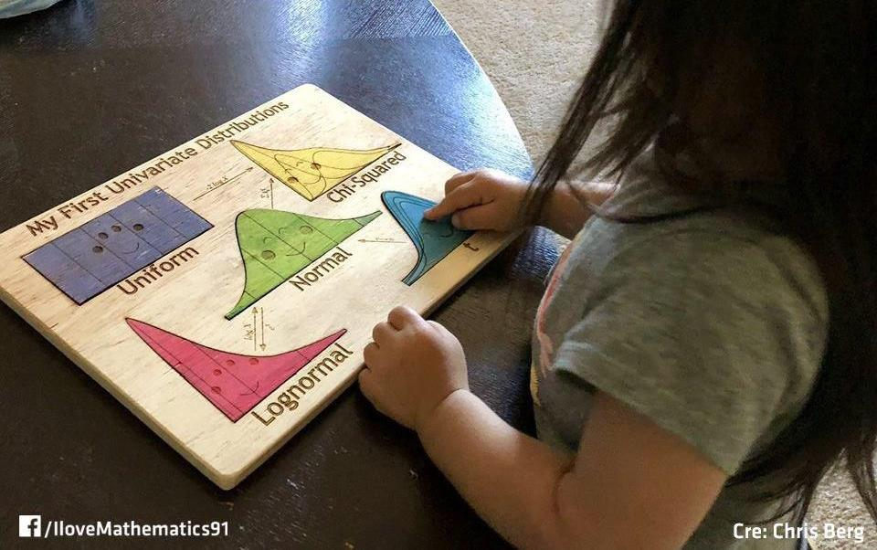
It needs Mathematics/Statistics …. “Thinking”

Slide 31
Data Science?
Notes:
Ini adalah peta sebagian besar Teknik/metode yang ada di data science yang sebagiannya juga digunakan dalam pengolahan data besar.
Namun jika dilihat perkomponen banyak yang mungkin akan bertanya: “bukankah itu sebagian besar sebenarnya statistic?”
Tanpa membahas detail lebih jauh bagian kanan mmg kebanyakan adalam model-model yang dipelajari oleh para statistician.
Menariknya sebgaian kiri lebih ke Machine Learning dan Deep Learning.
Lalu dimana letak Data Science-nya? … “Menurut saya”/opini saya DS di peta ini justru terletak pada kombinasi dari Teknik yang ada.
Supaya lebih jelas saya berikan sebuah contoh.

Slide 32
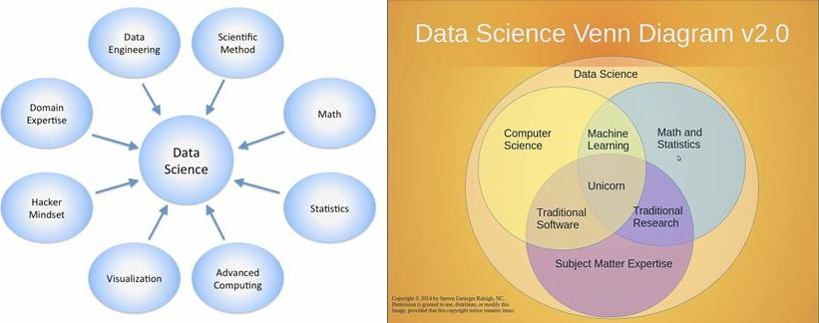
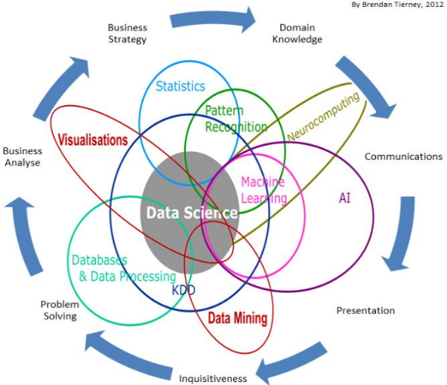
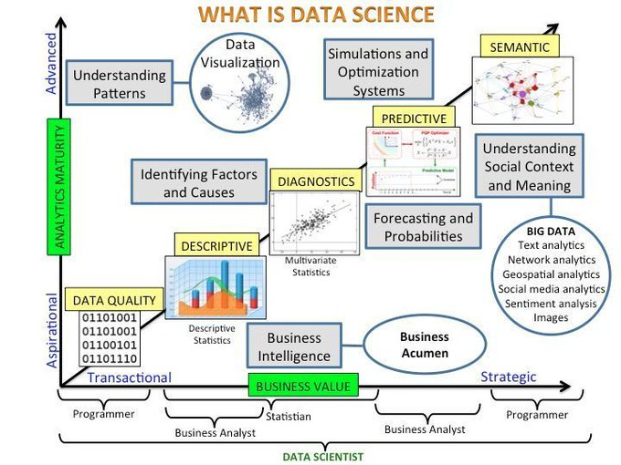
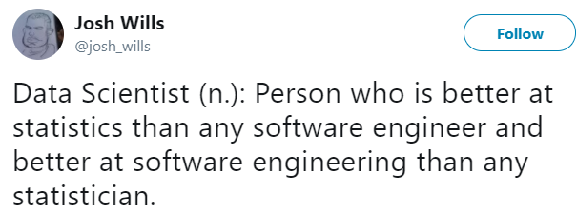
Data Science When we Google it
This is NOT the right way to explain what is Data Science https://www.kdnuggets.com/2016/10/battle-data-science-venn-diagrams.html
https://commons.wikimedia.org/wiki/File:DataScienceDisciplines.png
https://www.linkedin.com/today/post/article/20140625043146-111366377-data-science-bridging-the-business-it-gap
But wait!...
https://www.datasciencecentral.com/profiles/blogs/data-science-summarized-in-one-picture
Notes:
Itulah mengapa banyak yg mendefinisikan DS sebagai kombinasi dari berbagai bidang ilmu.
“Science”-nya sendiri karena seringnya kita harus men-”twist” model yang ada (tidak langsung pakai) seperti data mining.

Slide 33
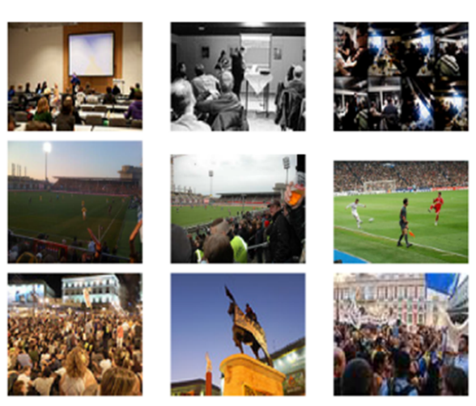
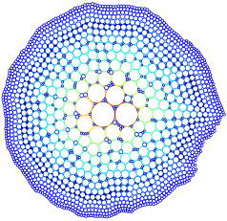
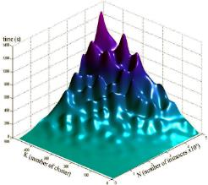
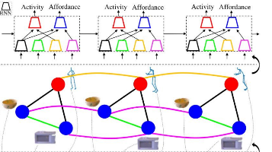
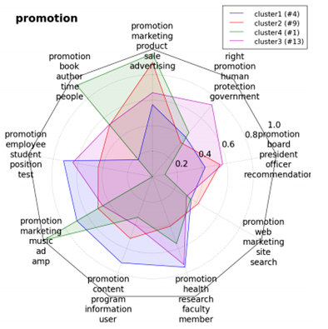
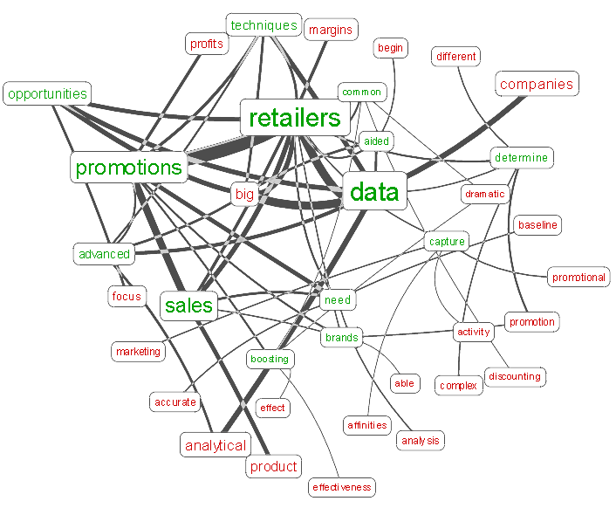
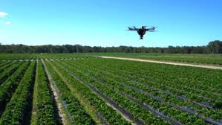

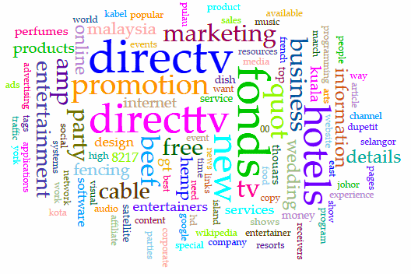
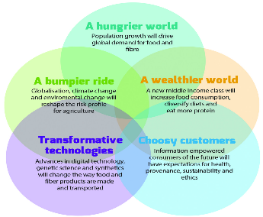
Data Science = Menyelesaikan masalah dengan science melalui data
Notes:
* About solving problems related to current data trends: fast growing, varied formats, can be large, etc.

Slide 34
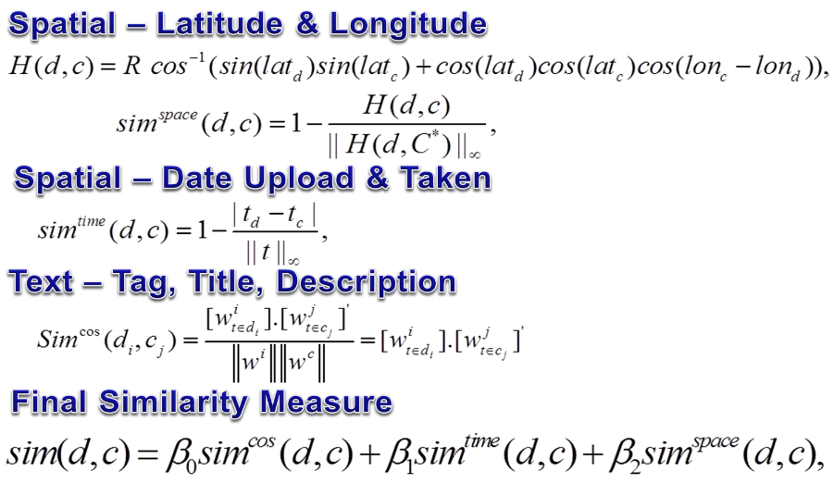
Social Event Detection
Significant number of documents (437,370)
High-dimensional data (>60,000)
Significant amount of noise & missing values
Multiple domain data (text, time, and spatial)
Relatively large number of clusters (fine-grained) (>20.000)
Varying cluster sizes, significant number of singletons & small clusters

Slide 35

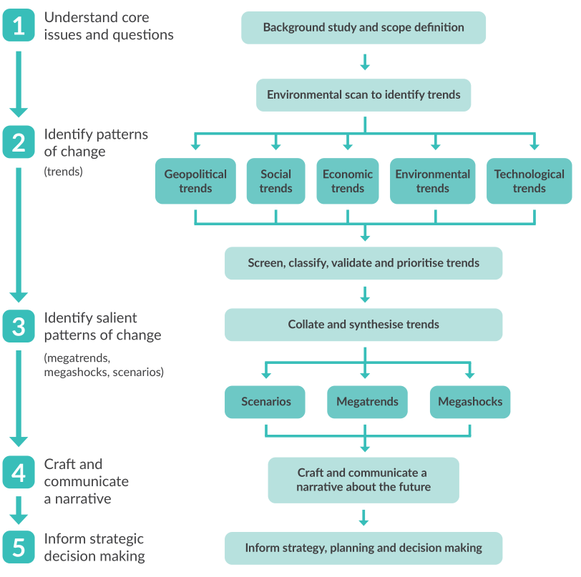
RIRDC – CSIRO
(Clustering Analysis + Time Series)
Supporting the development of rural industries and agriculture in Australia through Big Data analytics
Temporal Clustering on Social Media Data & Journal Summarizations

Slide 36
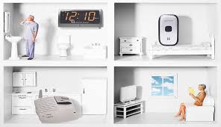
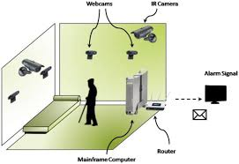
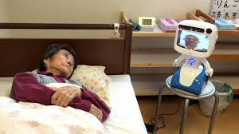
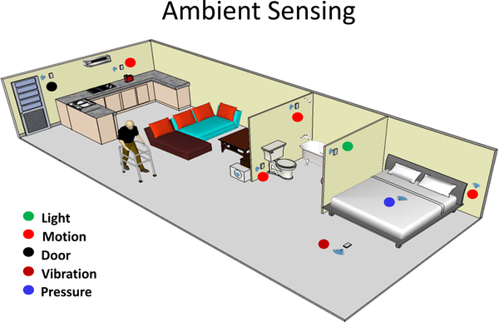

Episodes/Temporal Mining
(Outlier Detection: Graph Theory + Time Series)
Supporting the Health & Security of Elderly in Japan

Slide 37
Data Science The Essence
Providing solutions (insights) and not just information (as in Business Intelligence).
Answering to more complex data formats (text, image, video, graphs, etc).
Capability to scale data solution to larger volume of data (scalability).
Ability to provide real-time solutions on streaming (user-generated) data.
Innovative and creative applications from data analysis to create values.
Notes:
Pengalaman TNI
Pengalaman SED, Tohoku, dll

Slide 38

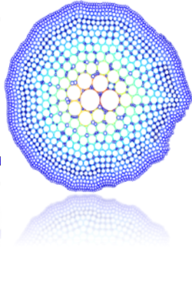
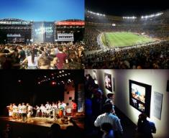
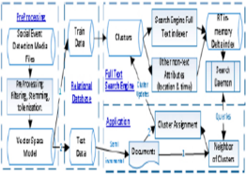
Definisi Data Science
Data science adalah sebuah bidang ilmu yang menggunakan metode dan proses-proses ilmiah, algoritma, dan sistem untuk mendapatkan pengetahuan dan wawasan (insight) terdalam dari suatu data terstruktur (tabular) dan tidak terstruktur.
Catatan: Sumber data Data Science biasanya berasal dari sistem Big Data
Kata Kunci: Text Mining, Machine Learning, rekomendasi, prediksi, dsb.
[2]. Dhar, V.: Data science and prediction. Commun. ACM. (2013). https://doi.org/10.1145/2500499.

Slide 39
Hubungan Big Data dan Data Science?

Slide 40
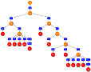















Good Old Days
Experiment,
Survey,
Administration,
Industry, etc
Statistics
M.L., A.I., B.I., B.A.
Data Mining
Six σ, Quant
Source
Methods
Relational Database,
Data warehouse,
PC, Workstation.
HPC, etc
Understand relationships
Find Patterns
Increase profit
Predict, forecast, etc
Majority structured
Can be large
Mostly Clean
Data quality ↑
Grow relatively slow
Technology
Applications
©Taufik Sutanto - 2017

Slide 41






























Big Data Era
Experiment,
Survey,
Administration,
Industry, etc
Variety
Statistic
M.L., A.I., B.I., B.A.
Data Mining
Six σ, Quant
Social Media
IoT, sensors, mobiles,
Weblogs/transactions
Bioinformatics, Satellite data, etc
Methods
Source
Data Science
Volume
Velocity
Big
Understand relationships
Find Patterns
Increase profit
Predict, forecast,
↑
Relational Database,
Data warehouse,
PC, Workstation.
HPC, etc
↑
Mostly Unstructured
Very large & Noisy
Data quality ↓
Grows rapidly
↑
↑
Generate Business
Social impact
e-Governance,
Public security & military, etc
Technology
Applications
©Taufik Sutanto - 2017
Notes:
Kerajaan api-nya MedSos, Smartphones, IoT/sensors, satellite, etc

Slide 42


Data Science
VS The Rest
Statistics [1 h, 1 d]
Data Mining [n h, 1-n d]
Artificial Intelligence [mimicking human intelligence]
Machine Learning [⊂ A.I., 1 task]
Business Intelligence [dashboard, aggregate, query, slice-dice]
Business Analytics [adv. models]
6 Sigma/Quant/TQM [QC]

Slide 43



Definisi Artificial Intelligence
Artificial Intelligence (Kecerdasan Buatan) adalah salah satu cabang ilmu pengetahuan yang berhubungan dengan pemanfaatan komputer yang dapat melakukan pekerjaan seperti atau bahkan lebih baik dari yang dapat dilakukan manusia.
Kata Kunci: Deep Learning, Computer Vision, reinforcement learning, dsb.

Slide 44

Popularity Trends

Slide 45



Sejarah Perkembangan Ilmu Data (ML/AI)
Feature Engineering
[*]. beamandrew.github.io/
Notes:
Disini polanya masih variasi dari pemodelan: by frekuensi (tree), geometri/margin di SVM, similarity kNN, NN dgn netwok based model, dsb
Apakah trend “approach” ini akan berlanjut.
Perhatikan scale timelinenya agak Panjang.
Kita harus jeli melihat trend jangka Panjang dan trend jangka pendek.
Setiap sekitar 10-15 tahun ada pendekatan yg “baru”, noveltynya sangat signifikan.

Slide 46


Slide 47
Deep Learning?
Makna "Deep" di DL sendiri bermakna "successive layers of representations" biasa juga disebut sebagai layered representations learning atau hierarchical representations learning.
Yang menjadi pembeda utama DL dengan NN/ML adalah "Learning representations from data".

Slide 48

Why Deep Learning?
Teori Deep Learning sebenarnya sudah cukup lama ada (dibahas):
convolutional neural networks dan backpropagation — 1989
The Long Short-Term Memory ( LSTM ) algorithm (timeseries DL) — 1997
Lalu mengapa baru tenar di 2012?
Hardware (terutama GPU)
Dataset (Big Data)
Perkembangan Algoritma terbaru : Better activation functions, weight-initialization schemes, optimization schemes (e.g.Adam W)

Slide 49

Internet of Things (IoT)

Slide 50
Profesi Terkait Data
Notes:
So my outlines are questions that will all together hopefully will answer our Big Question for the next 2 sessions: What is HR Analytics?

Slide 51

Notes:
Ndak punya banyak waktu, akan diberikan beberapa contoh saja.

Slide 52

Notes:
Ndak punya banyak waktu, akan diberikan beberapa contoh saja.

Slide 53
Faktor-faktor yang mempengaruhi perkembangan ilmu Data
Bentuk/Struktur Data (variety)
Volume & Velocity Data (scalability)
Teknologi
Applications or (Business) needs

Slide 54
Ilmu Data di Masa Depan di pengaruhi oleh:
Solution New Problems/Data Complexity (e.g. smart Homes, AR-VR, Education 4.0, etc.).
New Applications from current methods.
New Technology (e.g. GPU, FPGA, TPU, Quantum Computing, )
Currently unscalable/hardly scalable methods (e.g. Bayesian, DL, …)
Modelling optimized for technology (lots of new research gaps due to lots of frameworks)
Konvergensi solusi pengolahan data (Teknologi/framework, tapi bukan metode).
UN SDG: Climate, Energy, Education, poverty, etc.

Slide 55
Trend Research / Technology
Special Data Structure : (we are left behind by IR people)
Analysis on specially compressed data.
Analysis on (semi) preprocessed data (sorted, indexed, summarized)
Technology Development:
Quantum Computing (terutama terkait security dan optimasi)
5G (mempengaruhi WAN distributed computing)
GPU (cheaper, better, and easier frameworks/plugins)
Special cores for AI/ML.
Scalability:
Banyak penelitian masih fokus ke efisiensi (waktu) dan akurasi, tapi masih jarang scalability (memory dan komputasi)
Notes:
Kendala scalability – memang lebih sulit

Slide 56


Ilmu Data di Masa Depan (Pengaruh Lingkungan - Contoh)
IBM TrueNorth
use just 0.07 milliwatts of power and can perform 46 billion synaptic operations per second, per watt.
>6000 frames/watt
Tantangan: Arsitektur != CPU (menggunakan Synapse) Pemrograman Berbeda
Peluang: Minimal research Gaps!!!...

Slide 57


Big Data
merubah formulasi yang ada
https://www.datasciencecentral.com/profiles/blogs/the-death-of-the-statistical-test-of-hypothesis

Slide 58



Contoh Tantangan teknis 1: Curse of Dimensionality
Initially introduced by Richard E. Bellman (1957).
$$\lim_{dimension→∞}{\frac{Max_{Distance}−Min_{Distance}}{Min_{Distance}}=0}$$
http://www.visiondummy.com/2014/04/curse-dimensionality-affect-classification/
Classification
Clustering Analysis
[*]. Hinneburg, et.al.. "What is the nearest neighbor in high dimensional spaces?." 26th Internat. Conference on Very Large Databases. 2000.
Notes:
Most data Unstructured, missal Text ➔ Setiap

Slide 59


The Effects

Slide 60

Continued…. Representasi Cluster
Hubs: tendency of some data points in high-dimensional data sets to occur much more frequently in k-nearest neighbor lists of other points than the rest of the points from the set.
Radovanovi´c, et. al. Hubs in Space: Popular Nearest Neighbors in High-Dimensional Data, 2010
.

Slide 61


Tantangan Teknis: Long Tail (Pareto) Phenomena in Big Data
Notes:
Termasuk Buzzer, bots … dan cyber army.
Menghiraukan = Interpretasi yang bias

Slide 62


Tantangan Teknis: Fine-Grained Problems di Big Data
Notes:
Komputasi meningkat Exponential

Slide 63

Tantangan Teknis: Metode yang efisien untuk Big Data
Notes: Be critical when doing a literature review for methods that works on “large data”.
Notes:
Apakah scalable terhadap N, L, k atau?... Contoh Birch
Apakah mudah di paralelkan?
Berapa memory diapakai? ➔ Jarang paper kasih info ini, karena memang eksperimennya ndak gampang.

Slide 64



Present Challenges
Industri ➔ Akademis:
Contoh sederhana:

Slide 65



Clustering and Ranking
Case Study 1 : Clustering via Ranking
Bagaimana cara membuat agar model DS di BD lebih cepat & Efisien?

Slide 66







Mengapa Ranking (search)? : Motivasi
Notes:
What is ranking? ➔ simply ranking of most relevant docs as when we use Google.
Why Ranking? …. [Click #1]
But… I can not use Google Big Query …. As a student with 4 children and not working I don’t have the luxury of having Google Big Query … or Amazon Cloud AWS services
Fortunately… there are Good people out there that provides amazing Open Source solution … :) … [CLICK #2]

Slide 67

Cluster hypothesis legacy
“Closely associated documents tend to be relevant to the same requests”
[Jardine&van Rijsbergen ’71, van Rijsbergen ’79]
[Kurland 2013]
Notes:
So what is Cluster Hypothesis legacy?
There at least hundreds, if not THOUSANDS of studies surroung the cluster hypothesis Legacy …
It is one of the most important topic in Information Retrieval …
Notes that these are THE MILESTONES of research in Cluster Hypothesis …. My Research is not in these categories … It create another DIFFERENT milestones in the literatures
Why? [Click to next slide]

Slide 68

Optimum Clustering Framework:
Reversed Form of Clustering Hypothesis
Optimum clustering framework (OCF) [Fuhr 2012]. reversed form of cluster hypothesis legacy: “Documents relevant to the same queries should occur in the same cluster”
Using three components : set of Queries, probabilistic retrieval function, and similarity metric. Introduced new pairwise precision and recall as:
Fuhr, Norbert, et al. "The optimum clustering framework: implementing the cluster hypothesis." Information Retrieval 15.2 (2012): 93-115.
Notes:
One of the pioneer of research that have the same direction as my research is work by Fuhr et al in 2012 …. EXPLAIN …

Slide 69



OCF, Continued …
Expected Precision and Recall:
Define the OCF.
Notes:
Fuhr et al … provides a strong theoretical basis of RfC, BUT they did not propose any method/algorithm for the clustering….

Slide 70





Clustering via Ranking
Notes:
After a lot of questions, experiments, and headaches… finally I got some RESULTS ….
So here is our solution to the research problem ….

Slide 71
[1]. Loci : A dynamic Cluster Representation
[*] T. Sutanto and R. Nayak. Semi-supervised document clustering via loci. WISE, Springer,2015.
Notes:
So what is a cluster locus … explain what it is and how it works ….

Slide 72



Terinspirasi dari Biology (genetic)
Notes:
This is where I got the idea … again … inspired by God the Almighty …
This is where I learnt: “Knowledge is found,, not really invented”….
Explain … in genetics.. A locus is …

Slide 73


Representasi Cluster

Slide 74


Clustering via Ranking
Notes:
FGCR uses the same assumption as CLIQUE, that is dense region in higher dimension will also be dense in lower dimension.

Slide 75
Arsitektur Sistem
Notes:
FGCR uses the same assumption as CLIQUE, that is dense region in higher dimension will also be dense in lower dimension.

Slide 76

Performa – Scalability
Dataset | N | L | k | method | time (s) | Mem (MB)
twitter | 2,686,877 | 367,388 | 54,897 | FGCR | 61,480 | 4,238
 |  |  |  | Mbkm | 1,866,613 | 16,260
Instagram | 764,521 | 126,250 | 100,863 | FGCR | 7,169 | 2,314
 |  |  |  | Mbkm | > 3,600,000 | 18,898
Google+ | 634,344 | 390,665 | 23,845 | FGCR | 8,940 | 2,588
 |  |  |  | Mbkm | 1,063,852 | 14,182
facebook | 1,615,685 | 261,734 | 53,756 | FGCR | 23,768 | 3,675
 |  |  |  | Mbkm | 2,332,020 | 16,415

Slide 77
Clustering Performance
Datasets | N | L (dimension) | Time
SED 2014 | 358,922 | 55,974 | 7.2 Mnt
SED 2013 | 437,370 | 62,890 | 12.3 Mnt
Medline | 9,852,009 | 1131420 | 5.9 Hrs
Wikipedia | 8,697,344 | 9,551,721 | 18.3 Hrs
Single core processing (2.3 Ghz).
Python 3.5, 1Gbs network speed.
VSM and Query generating not included.
Search results cached, Full dimensional.
Standard preprocessing: stopwords, lowercase, symbol, and freq based removals.
Notes:
Notes …. From more than 3 weeks … down to just 7 minutes …. Only with a single processor…

Slide 78



Slide 79


Slide 80

Distributed Types
Collaborative
Locally optimized distributed DS/ML
Main Challenge: Communication Cost
Global
Globally optimized distributed DS/ML.
Main Challenge: Quality

Slide 81



“Ilustrasi” Optimasi (semi-supervised) k-Means on Distributed Data & Computing

Slide 82
Communication Models Q(i,j)
Model Communication
Representative Communication
Data Communication
cluster Centroids (Datta et al., 2006)
cluster Dendogram (Debzani et al. 2006,Samatova et al., 2002).
Probabilistic Word Distributions (Papapetrou et al. 2012)
Cluster Summarization (Hammouda, 2014)
Kdec distributed algorithm (Klusch et al., 2003)
Dbdc algorithm (Januzaj et al., 2004)
K. M. Hammouda & Kamel, 2006;
Li & Morris, 2002

Slide 83



Distributed (Document) Clustering, Some Examples
Hammouda et al. 2014
Debzani et al. 2006
Papapetrou et al. 2012
Notes:
Generally how distributed clustering is done, and give illustration why it is not just a matter of parallelization.

Slide 84
Bagaimana Jika Sebagian Data Private?
Industry besar (corporates) memiliki Data yang terhubung lewat WAN & akses antar database lebih terbatas (confidentiality/security issues) dan jumlah total ukuran data lebih besar.
Regresi Logistik pada system dimana data dan komputasi terdistribusi “Distributed learning algorithms for Big Data”, Pedro Guerreiro and Joao Xavier, ECMI SIG, 2017

Slide 85







Permasalahan & Tujuan: RL klasik
Odds

Slide 86






1: Sequential Processing Menggunakan random walk – Undirected Graph

Slide 87




2: Directed Graph?

Slide 88




3: Semua Nodes Secara Simultan?

Slide 89






Contoh Pengaruh Teknologi
Terhadap Pemodelan DS/ML/AI

Slide 90
Tantangan di
Sektor Pendidikan
Notes:
So my outlines are questions that will all together hopefully will answer our Big Question for the next 2 sessions: What is HR Analytics?

Slide 91









Riset Abad 21 … Sulit?

Slide 92





Rodrigo Ramele
Mind Controlled Wheel Chair
HOW ???...Impossible???

Slide 93


Riset & Teknologi
Sulit ??? …
Seorang remaja Aidan Dwyer (13 tahun) meningkatkan efisiensi Solar Cell hingga 50% dgn mengikuti geometri pohon [Barisan Fibonaci].

Slide 94

Pendidikan 4.0?
“… This scenario suggests 21st-century skills or lifelong learning competencies, including knowledge construction; adaptability; the ability to find, organize, and retrieve information; management; critical thinking; and teamwork.” [*]
[*] Demartini, C., & Benussi, L. (2017). Do Web 4.0 and Industry 4.0 Imply Education X. 0?. IT Professional, 19(3), 4-7.
Notes:
Tidak harus sejalan
Kalaupun ada “Pendidikan 4.0” ➔ industry 4.0 harus well-established terlebih dahulu.

Slide 95

Expected Competencies
“… This scenario suggests 21st-century skills or lifelong learning competencies, including knowledge construction; adaptability; the ability to find, organize, and retrieve information; management; critical thinking; and teamwork.” [*]
[*] Demartini, C., & Benussi, L. (2017). Do Web 4.0 and Industry 4.0 Imply Education X. 0?. IT Professional, 19(3), 4-7.
Why?
Notes:
Mungkin masyarakat umum berfikirnya Pekerjaan sulit / lapangan kerja sedikit.
Pengalaman saya ketika merekrut tenaga kerja, sebenarnya kurang cocoknya kebutuhan VS tenaga kerja yang tersedia
Bahkan jika ada yang berfikir bahwa yang banyak hanya pekerjaan dengan gaji kecil, mohon maaf sebagai pengusaha berani mengatakan hal ini kurang tepat.
Bagi pengusaha sebenarnya tidak sulit sama sekali untuk menggaji besar seorang karyawan selama skill yang dimilikinya sepadan dengan apa yang dikontribusikan ke perusahaan.
Dan untuk hal tsb perusahaan “biasanya/setau saya” masih untung besar.
Misal suatu perusahaan mendapat suatu project digital senilai 3M selama setahun.
Memiliki team 10 orang dgn gaji 2 digit masih menyisakan untung yg relative besar bagi perusahaan.
Belum jika personel di team tsb mengerjakan lebih dari satu project. Tapi mencari karyawan seperti ini cukup sulit.
Masalahnya mahasiswa kita minim informasi skill seperti apa yang dibutuhkan oleh perusahaan.

Slide 96

Different Industry Needs
Notes:
Merubah apa yang kita cari dari calon tenaga kerja

Slide 97

Mismatch Competency
Notes:
So my outlines are questions that will all together hopefully will answer our Big Question for the next 2 sessions: What is HR Analytics?

Slide 98






Google & Apple among 15 top companies where you can get hired without a college degree (The list is growing)
Google
Ernst and Young
Penguin Random house
Costco Wholesale
Whole Foods
Home Depot
IBM
Bank of America
Chipotle
Lowe's
Hilton
Publix
Apple
Starbucks
Nordstrom
https://www.techrepublic.com/article/google-apple-among-15-top-companies-where-you-can-get-hired-without-a-college-degree/
Notes:
Yang perlu diperhatikan juga (terutama oleh pemerintah) adalah mulai adanya perubahan culture akademik besar-besaran di industry (stake holder).
Di level nasional sendiri saya secara langsung berdiskusi dgn beberapa CEO dan meng-aminkan trend diatas.
Hal ini berarti ada masalah dgn system Pendidikan yg ada. Menurut saya terlalu sulit dgn birokrasi dan aturan yg ada saat ini untuk PT menjadi adaptif thd perkembangan kebutuhan industry.
Contoh pengalaman saya merubah kurikulum …. Atau contoh PT lain yg prodinya ditutup karena katanya nomenklatur keilmuannya tidak ada dalam rumpun ilmu.

Slide 99

Pascasarjana Tanpa Gelar Sarjana?
https://www.cnbc.com/2017/07/14/skip-college-and-go-to-graduate-school-with-new-mit-program.html
Notes:
Master tanpa S1, bahkan tidak perlu ijazah HighSchool.
Trend semakin banyak yg HomeSchool juga perlu dicermati oleh pemerintah sebagai suatu indicator bahwa ada sesuatu yang harus ditindak lanjuti.
Di luar negeri Pendidikan begitu “luwes”

Slide 100






Kalau peran Gelar/Ijazah semakin berkurang signifikansinya, lalu apa validasi kompetensi yang dilihat industri saat ini?

Slide 101

Arahan Menteri Baru

Slide 102
Tantangan Sistem Kurikulum Konvensional
Update: 2-5 tahun sekali
Unit waktu yang sama untuk semua mata kuliah (14-16 pertemuan/MK)
Tidak fleksible: bergantung aturan akreditasi dan asosiasi.
Kelemahan Sistem Pendidikan informal (Kursus/training)
Biaya
Keterurutan pembelajaran
Kemampuan praktis yang terlalu instant (shallow knowledge)

Slide 103
tau-data RoadMap

Slide 104
Data Analyst/Scientist ~ Insight

Slide 105
Universitas Hasanuddin
Fakultas MIPA – Departemen Statistika
Makassar, 03-04 Februari 2020
“Your partner in data solution, research, & education”
End of Module 01
Terima Kasih
Taufik Sutanto
https://tau-data.id/unhas

